Slide 1
UNIT-3

Slide 2
Memory System

Slide 3
Introduction
Goal: To provide the programmer with a large storage capacity for programs and data
Effects the speed with which the CPU fetches the data from the memory
Two types of memory
Read/write random access memory (RAM)
Read only memory (ROM)

Slide 4
Introduction contd.,
For both RAM and ROM the time required to access a specific word is independent of its location
Sequential memory – Magnetic Tape – access time to a particular data item depends on its relative location. Reading the n^{th} word requires that the previous n-1 words be read first

Slide 5
Memory Capacity
Number of bytes that can be stored

Slide 6
Key Characteristics
Location
CPU
Internal (main)
External (secondary)
Capacity
Word size
Number of words
Unit of transfer
Word
Block
Access methods
Sequential access
Direct access
Random access
Associative access
Performance
Access time
Cycle time
Transfer rate

Slide 7
Key Characteristics contd.,
Physical Type
Semiconductor
Magnetic surface
Optical
Physical Characteristics
Volatile / Non-Volatile
Erasable / Non-erasable
Organization

Slide 8
Location
Three locations of memories
CPU
Registers – used by CPU as its local memory
Internal memory
Main memory
Cache memory
External memory
Peripheral devices – disk, tape – accessible to CPU via I/O controllers

Slide 9
Capacity
Internal memory capacity is expressed in terms of bytes or words.
External memory capacity is expressed in terms of bytes (depends on words in memory)
Total memory = number of words × word length
Number of words = 2^{address bus width}
Word length = Data bus width

Slide 10
Unit of transfer
Internal memory – number of data lines into and out of the main memory module
External memory – blocks – longer units than a word

Slide 11
Access Methods
Four types
Sequential Access
Shared read/write head is used, and this must be moved its current location to the desired location, passing and rejecting each intermediate record.
So, the time to access an arbitrary record is highly variable
Accesses the memory in predetermined sequence
Slower than random access memory
Ex: Magnetic Tapes
Motion
Read – write head

Slide 12
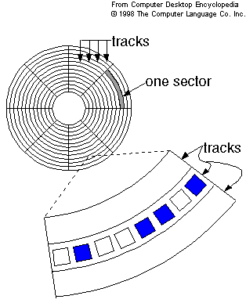
Access Methods contd.,
Direct access
Also referred as semi random access memory
Shared read/write head is involved.
Access time is variable
The track is accessed randomly but access within each track is serial
Ex: Magnetic Disk

Slide 13
Access methods contd.,
Random Access
Each addressable location in memory has unique, physically wired – in addressing mechanism
Time to access a location is independent of the sequences of prior access and is constant
Main memory systems are a random access
Storage locations can be accessed in any order
Semi conductor memories
Read write head selector
Read write heads
Storage locations

Slide 14
Access Methods contd.,
Associate Access
Word is retrieved based on portion of its contents rather than its address
Has own addressing mechanism
Retrieval time is constant
Access time is independent of location or prior access patterns
Cache memories

Slide 15
Performance
Access time
The time required to read / write the data from / into desired record
Depends on the amount of data to be read / write
Random access memory
Time from the instant that an address is presented to the memory to the instant that data have been stored or made available for use.
Non-random access memory
Time it takes to position read-write head at the desired track (seek time) + transfer time + to position read-write head at the desired sector (rotational latency)
Memory Cycle time
Access time + time required before a second access can commence
Access + latency

Slide 16
Performance contd.,
Transfer rate
Rate at which the data can be transferred into or out of a memory unit
Random access memory
1/cycle time
Non-Random access memory
T_{n} = T_{a} + (N/R), where
T_{n} – average time to read or write N bits
T_{a} – average access time
N – Number of bits
R – Transfer rate, in bits per second (BPS)

Slide 17
Physical characteristics
Volatile memory
Information decays naturally or lost when electrical power is switched off
Non-volatile memory
Once recorded is retained until deliberately changed
No electrical power is needed to retain information
Magnetic surface memories
Semiconductor memories may be either volatile or non-volatile
Non-erasable memory
Cannot be altered, except by destroying the storage unit (ROM)
A practical non-erasable memory must also be non-volatile

Slide 18
Organization
Physical arrangement of bits to form words
2 types
1 dimensional
2 dimensional

Slide 19
Byte Storage Methods
Big-Endian
Assigns MSB to least address and LSB to highest address
Ex: 0 × DEADBEEF
Memory Location | Value
Base Address + 0 | DE
Base Address + 1 | AD
Base Address + 2 | BE
Base Address + 3 | EF

Slide 20
Byte Storage Methods contd.,
Little Endian
Assigns MSB to highest address and LSB to least address
Ex: 0 × DEADBEEF
Memory Location | Value
Base Address + 0 | EF
Base Address + 1 | BE
Base Address + 2 | AD
Base Address + 3 | DE

Slide 21
Byte Storage Methods contd.,
Little Endian
Intel × 86 family
Digital equipment corporation architectures (PDP – 11, VAX, Alpha)
Big Endian
Sun SPARC
IBM 360 / 370
Motorola 68000
Motorola 88000
Bi-Endian
Power PC
MIPS
Intel’s 64 IA - 64

Slide 22
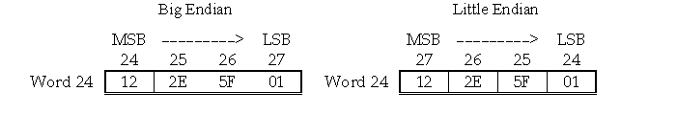
Example
Example: Show the contents of memory at word address 24 if that word holds the number given by 122E 5F01H in both the big-endian and the little-endian schemes?

Slide 23

Recap: Find the Memory characteristics that are hidden

Slide 24
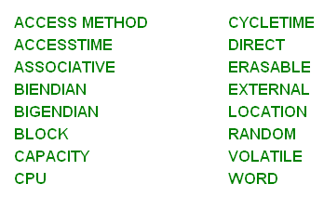
The hidden Memory Characteristics are:

Slide 25
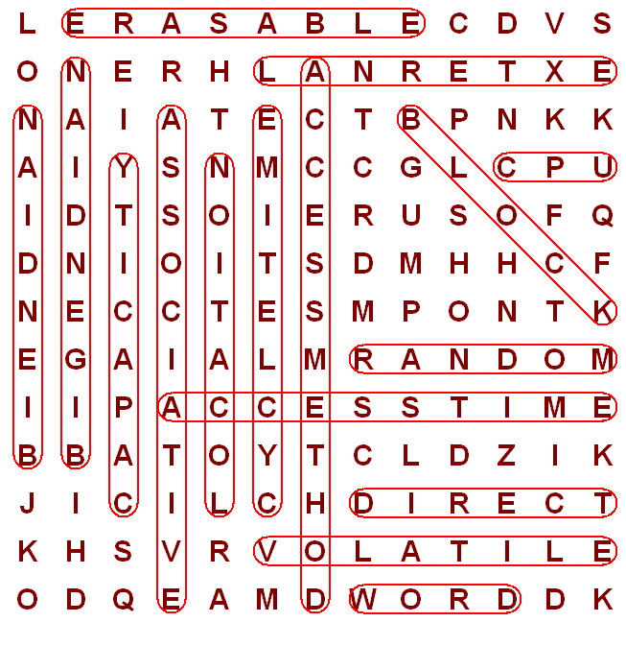
Solved puzzle

Slide 26
Memory hierarchy
Multilevel memory system
MP
Cache
Level 2
Main
memory
Secondary
memory
CPU
Cache
Level 1
Reg file

Slide 27
CPU REGISTER
Temporary storage of inst & data.
Usually form as general purpose register file for storage data as it is processed.
Each register in the register file can be individually addressed.
MAIN MEMORY
Program and data that are in active use.
Storage locations in the main memory are directly addressed by CPU.
Access time is more than CPU register and the capacity of main memory is large and it is physically separable from CPU.

Slide 28
SECONDARY MEMORY
Large in capacity but slower than main memory.
Stores programs, data files are not required by the CPU.
Access time is large when compared with main memory.
CACHE
Positioned b/w CPU register and main memory
Several levels of cache memory is also available.
Storage capacity is less but its access time is less than main memory.
The goal of every memory system is to provide adequate storage capacity with an acceptable level of performance and cost.

Slide 29
Memory hierarchy contd.,

Slide 30
Random-access memories
Storage unit composed of a large number (2m) of addressable locations.each of which stores a w-bit word.
The address of the target location to be accessed is transferred via the address bus to the RAM’s address buffer.
The address is then processed by the address Decoder,which selects the required location in the storage cell unit.
A control line indicate the type of access to be performed. If a read operation (load) is requested , the contents of the addressed location are transferred from the storage cell unit to the data buffer and from there to the data bus.
If a write (store) is requested, the word to be stored is transferred from the data bus to the selected location in the storage unit.

Slide 31
The storage unit is made up of many identical 1-bit memory cells and their interconnections.
The actual no of line connected to the cell and their functions depend on the memory tech and addressing scheme .
Each cell is connected to a set of data , address, and control signals.
One physical line often has several logical function. Ex both address and data.
The drivers, decoders, and control circuits form the access circuitry of RAM an can have significant impact on the total size and cost of the memory.

Slide 32
2-D RAM addressing scheme
The m-bit address word is divided into two parts x any y consist Mx and
My bits resp.
Total no of cells N=NxNy.
A cell is selected by the coincidence of signal applied to its X and Y address lines.
The 2-D org requires much less access circuitry than 1-D org for same storage capacity.

Slide 33
Semiconductor RAMs
Two categories:
SRAMs
DRAMs
SRAM
SRAM consists of memory cells that resemble the flip-flop used in processor design.
SRAM cells differ from flip-flop primarily int the methods use to address the cell an transfer data to and from them.
Multifunction lines minimize storage-cell complexity and the number of cell connections thereby facilitating the manf of very large 2-D array of storage cells.

Slide 34
DRAM
The DRAM cell the 1 and 0 states correspond to the presence or absence of stored charge in a capacitor controlled by a transistor switching circuit
Single transistor whereas a static cell requires up to six transistors higher storage density is achieved with DRAM
The charge stored in a DRAM cell tends to decay with time and cell must be periodically refreshed.
SRAM and DRAM are volatile, the stored infor is lost when the power source is removed.

Slide 35
A) The six-transistor SRAM cell superficially resembles a flipflop. A signal applied to the address line (word line) by the address ecoder selects the cell for either the read or write operation.
The two data line also bit line are used in a complex way to transfer the stored data and its complement between the cell and the data drivers.

Slide 36
B) one transistor DRAM cell comprises an MOS transistor T,which acts switch and capacitor C, which stores a data bit .
Apart form power an ground the cell has only tow external connections data(bit) line is place on the data line.
A signal is applied to the address line to switch on T. This action transfers a charge to C if the data line 1 no charge is transferred otherwise.
To read the cell, the address line is again activated transferring any charge stored in C to the data line where it is detected. Since the readout process is destructive the data being read out is amplified and subsequently written back to the cell this process may be combined with the periodic refreshing operation required by dynamic memories

Slide 37
Advantage
Small size which means that ICs with very high cell density can be manf and low power consumption.

Slide 38
Cache memory
If the active portions of the program and data are placed in a fast small memory the average memory access time can be reduced ,thus reducing the total execution time of the program.
Such fast small memory is referred to cache memory.
It is placed between the CPU and main memory .
CM access time is less than access time of MM hierarchy by a factor 5 to 10.
The cache is the fastest component in the memory hierarchy and approaches the speed of components.

Slide 39
operation of the cache: if the word is found in the cache ,it read from the fast memory.
if the word addressed by the CPU is not found in the cache, the main memory is accessed to read the word.
A block of words containing the one just accessed is then transferred from main memory to cache memory.

Slide 40
Hit ratio:
The performance of cache memory is frequently measured in terms of a quantity called hit ratio.
When the CPU refers to memory and finds the word in cache, is said hit.
If the word is not found in cache, it is in main memory and it count as miss.
The ratio of the number of hits divided by the total CPU references to memory (hits plus misses) is the hit ratio.
The basic characteristic of cache memory is fast access time. Therefore very little or no time must be wasted when searching for words in the cache .
The transformation of data from main memory to cache memory is referred as mapping process

Slide 41
mapping
Associative mapping
Direct mapping
Set-associative mapping
Ex
CPU
Main memory
32KX12
Cache
512 X 12

Slide 42
Associative mapping
Associative mapping cache
CPU address(15)
Argument reg
address
data
01000
3450
02777
6710
22345
1234

Slide 43
The associative memory stores both address and content (data) of the memory word. This permits any location cache to store any word from main memory .
Address-15 and data-12.
A CPU address of 15 bits placed in the argument register and associative memory is searched for a matching address.
If address is found, the corresponding 12 bit data is read and sent to the CPU.
If no match occurs the main memory is accessed for the word. the address data pair is then transferred to the associative cache memory. If the cache is full an address data pair must be displaced to make room for a pair that is needed and not presently in the cache.

Slide 44
Direct mapping
Associative memories are expensive compared to random-access memories because of the added logic associated with each cell.
9 bits
6 bits
tag
index
32 K X 12
Main memory
Address=15 bits
Data = 12 bits
512 X 12
Cache memory
Address=9 bits
Data=12 bits
00 000
000
77 777
777

Slide 45
2(k) words in cache memory 2(n) MM
N bit divided into two fields k bits index and n-k bits for tag field.
Memory add
00000
1220
Index add
tag
data
000
00
1220
00777
2340
02000
5670
02777
6710
777
02
6710
Cache memory
Main memory

Slide 46
DIRECT MAPPING
Cache Memory
Direct Mapping with block size of 8 words
Index
tag
data
6
6
3
Block 0
000
0 1
3 4 5 0
Tag Block Word
007
0 1
6 5 7 8
010
INDEX
Block 1
017
Block 63
770
0 2
777
0 2
6 7 1 0

Slide 47
Set Associative Mapping Cache with set size of two
Index
Tag
Data
Tag
Data
000
0 1
3 4 5 0
0 2
5 6 7 0
777
0 2
6 7 1 0
0 0
2 3 4 0

Slide 48
Set associative mapping
Replacement algorithm
When a miss occurs in a set-associative cache and set is full ,it is necessary to replace one of tag-data items with a new value. Most common replacement algorithm used (FIFO) and least recently used (LRU).
With random replacement policy, control choose one tag-data item for replacement at random.
FIFO procedure selects for replacement the item that has been in the set the longest.
LRU algorithm selects for replacement the item that has been least recently used by CPU.

Slide 49
CACHE WRITE
Cache Memory
Write Through
When writing into memory
If Hit, both Cache and memory is written in parallel
If Miss, Memory is written
For a read miss, missing block may be
overloaded onto a cache block
Memory is always updated
-> Important when CPU and DMA I/O are both executing
Slow, due to the memory access time
Write-Back (Copy-Back)
When writing into memory
If Hit, only Cache is written
If Miss, missing block is brought to Cache and write into Cache
For a read miss, candidate block must be
written back to the memory
Memory is not up-to-date, i.e., the same item in
Cache and memory may have different value

Slide 50
Cache initialization.
Cache is initialized when power is applied to the computer on when main memory is loaded with a complete set of program from auxiliary memory .
After initialization the cache is considered to be empty but in effect it contains some non valid data indicate each word in cache a valid but to indicate whether or not the word contains valid data cache it initialized by clearing all valid bits to 0 valid bit of a particular cache word is set to 1 the first time this word is loaded from main memory and stays set unless the cache has to be initialized again.

Slide 51
Problem -1
A digital computer has a memory unit of 64 K X 16 and a cache memory of 1K words. The cache uses direct mapping with a block size of four words.
A) How many bits are there in tag, index, block and word fields of
the address format?
b) How many bits are there in each word of cache and how are
they divided into functions? Include a valid bit.
c) How many blocks can the cache accommodate?

Slide 52
SOLUTION
Memory capacity--- 64KX16
Cache capacity------1KX16
Direct mapping with block size ---4 word
a) Memory space=
Therefore words in memory
Therefore 16 bits are required to address the memory
Cache words
10 bits are register to address the cache
tags
index
6 bits
10 bits
16 bits

Slide 53
Cache divided into blocks of 4 words
Number of blocks ---- = blocks
256 blocks
Tag
block
word
6 bits
8 bits
2 bits

Slide 54
b) Tag bits + data word bits +valid bit
6 + 16 + 1--→ 23 bits
Blocks =256 blocks
2) An address space is specified by 24 bits and coresponding memory space by 16 bits.
How many words are there in the address space?
How many words are there in the memory space?
If a page consists of 2K words, how many pages and blocks are there in the system?
Address space—24 bits
memory space—16 bits
a) Words in address space –
b) Words in memory space --
c) Page size – 2K words
How many pages --- = = =8k
How many blocks------ = = = 32 blocks

Slide 55
PROBLEM 3
How many 128 X 8 RAM chips are needed to provide a memory capacity of 2048 bytes?
How many lines of the address bus must be used to access 2048 bytes of memory? How many of these lines will be common to all chips?
How many lines must be decoded for chip select? Specify the size of the decoders?

Slide 56
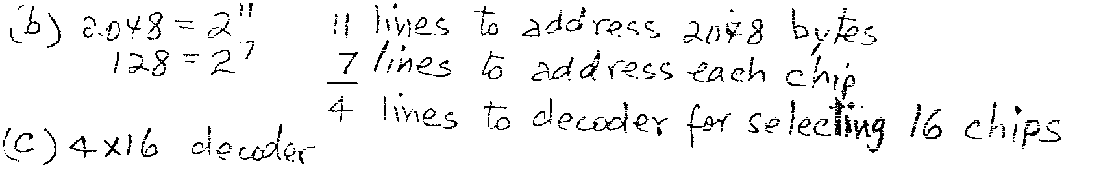
SOLN

Slide 57
Problem 4
A 16MB main memory has 32 KB cache with 8 bytes per line
i) How many lines are there in the cache?
ii) Show how the main memory and cache memory is
organized when the cache is direct-mapped.
iii) Show how the Main memory address is partitioned.

Slide 58
VIRTUAL MEMORY
Virtual Memory
Give the programmer the illusion that the system has a very large memory,
even though the computer actually has a relatively small main memory
Address Space(Logical) and Memory Space(Physical)
address space
memory space
virtual address
(logical address)
Mapping
physical address
address generated by programs actual main memory address
Address Mapping
Memory Mapping Table for Virtual Address -> Physical Address
Virtual address
Virtual
Memory
Main memory
address
mapping
address
Main
register
table
register
memory
Physical
Address
Memory table
Main memory
buffer register
buffer register

Slide 59
ADDRESS MAPPING
Virtual Memory
Address Space and Memory Space are each divided
into fixed size group of words called blocks or pages
1K words group
Page 0
Page 1
Address space
N = 8K = 2¹³
Page 2
Block 0
Page 3
Memory space
M = 4K = 2¹²
Block 1
Page 4
Block 2
Page 5
Block 3
Page 6
Page 7
Organization of memory Mapping Table in a paged system
Page no.
Line number
1 0 1
0 1 0 1 0 1 0 0 1 1
Virtual address
Table
Presence
address
bit
000
0
Main memory
001
11
1
Block 0
010
00
1
Block 1
011
0
0 1
0 1 0 1 0 1 0 0 1 1
Block 2
100
0
Main memory
Block 3
101
01
1
address register
Memory page table
110
10
1
111
0
MBR
01
1

Slide 60
ASSOCIATIVE MEMORY PAGE TABLE
Virtual Memory
Assume that
Number of Blocks in memory = m
Number of Pages in Virtual Address Space = n
Page Table
- Straight forward design -> n entry table in memory
Inefficient storage space utilization
<- n-m entries of the table is empty
- More efficient method is m-entry Page Table
Page Table made of an Associative Memory
m words; (Page Number:Block Number)
Virtual address
Page no.
1 0 1
Line number
Argument register
1 0 1 0 0
Key register
0 0 1 1 1
0 1 0 0 0
Associative memory
1 0 1 0 1
1 1 0 1 0
Page no.
Block no.
Page Fault
Page number cannot be found in the Page Table

Slide 61
Mapping table may be stored in separate memory or in main memory .
Case1:
Additional memory unit is required as well as one extra memory access time.
Case2:
Table space from MM and two accesses to memory are required with pgm running at half speed.
Case3:
Use associative memory.

Slide 62
PAGE REPLACEMENT ALGORITHMS
Virtual Memory
FIFO
Reference string
7
0
1
2
0
3
0
4
2
3
0
3
2
1
2
0
1
7
0
1
7
7
7
2
2
2
4
4
4
0
0
0
7
7
7
0
0
0
3
3
3
2
2
2
1
1
1
0
0
1
1
1
0
0
0
3
3
3
2
2
2
1
Page frames
FIFO algorithm selects the page that has been in memory the longest time
Using a queue - every time a page is loaded, its
identification is inserted in the queue
Easy to implement
May result in a frequent page fault
-
Optimal Replacement (OPT) - Lowest page fault rate of all algorithms
Replace that page which will not be used for the longest period of time
Reference string
7
0
1
2
0
3
0
4
2
3
0
3
2
1
2
0
1
7
0
1
7
7
7
2
2
2
2
2
7
0
0
0
0
4
0
0
0
1
1
3
3
3
1
1
Page frames

Slide 63
PAGE REPLACEMENT ALGORITHMS
Virtual Memory
LRU
- OPT is difficult to implement since it requires future knowledge
- LRU uses the recent past as an approximation of near future.
Replace that page which has not been
used for the longest period of time
Reference string
7
0
1
2
0
3
0
4
2
3
0
3
2
1
2
0
1
7
0
1
7
7
7
2
2
4
4
4
0
1
1
1
0
0
0
0
0
0
3
3
3
0
0
1
1
3
3
2
2
2
2
2
7
Page frames
- LRU may require substantial hardware assistance
- The problem is to determine an order for the frames
defined by the time of last use

